Slide 1
Inheritance
Programming Language Design and Implementation
(4th Edition)
by T. Pratt and M. Zelkowitz
Prentice Hall, 2001
Section 7.1-7.2

Slide 2
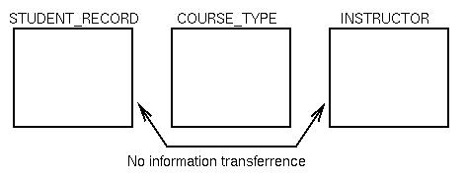
Encapsulated data types
Remember from previously: An ADT with:
Type with set of values
Set of operations with signatures
Representation - component structure of data type
Only the type name and operations are visible outside of the defining object.
Example: StudentRecord is type
Externally visible:
void SetName(StudentRecord, Name)
name GetName(StudentRecord)
Internal to module:
char Name[20];
float GPA;
char Address[50];
CourseType Schedule[10];

Slide 3
Implementation of encapsulation
Usual Implementation in Ada:
package RationalNumber is
type rational is record -- User defined type
num, den: integer
end record;
procedure mult(x in rational; -- Abstract operation
y in rational; z out rational);
end package;
package body RationalNumber is -- Encapsulation
procedure mult(x in rational;
y in rational; z out rational)
begin
z.num := x.num * y.num;
z.den := x.den * y.den;
end;
end package;

Slide 4
Use of encapsulated data
Usual use of encapsulated RationalNumber:
Example: In main procedure do:
var A, B, C: rational;
A.num := 7; ⇐ Should be illegal
A.den := 1;
Mult(A, B, C);
No enforcement of encapsulation
Any procedure has access to components of type rational. Can manipulate A.num and A.den without using procedures in package RationalNumber.
Let's look at alternative model to enforce encapsulation.

Slide 5
Private types
package RationalNumber is
type rational is private; -- User defined type
procedure mult(x in rational; -- Abstract operation
y in rational; z out rational);
private
type rational is record -- User defined type
num, den: integer
end record;
end package;
package body RationalNumber is -- Same as before
procedure mult(x in rational;
y in rational; z out rational)
begin
z.num := x.num * y.num;
z.den := x.den * y.den;
end;
end package;

Slide 6
Private types add protection
But now:
var A: rational;
A.num := 7; -- Now illegal. Private blocks use of num and den outside of package RationalNumber.
What is role of private?
Any declarations in private part is not visible outside of package
What is difference in semantics of rational?
What is difference in implementation of rational?
This solution encapsulates and hides implementation details of rational.

Slide 7
C++ RationalNumber example
C++ creates objects of a user defined class.
Data storage
Set of operations
Type rational can be specified in C++ as:
class rational{
public: void mult( rational x; rational y)
{ num = x.num * y.num;
den = x.den * y.den;}
protected: int num; int den }
rational A, B, C;
A.mult(B,C) ⇐ invoke encapsulated function
A.num = B.num * C.num ⇐ Illegal. No access to num and den

Slide 8
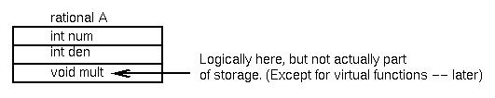
Storage for C++ classes
Visibility of objects:
public: globally known
private: locally known only
protected -- provides for inheritance

Slide 9
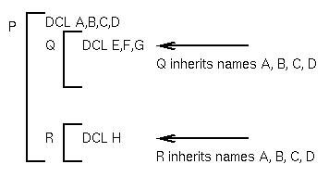
Inheritance
Inheritance provides for passing information from one data object to another automatically
It provides a form of data scope similar to syntactic scope.
Inheritance through
data in object
oriented languages
is explicit through
derived types.
Static scope (above) -
Names are known implicitly
through nested
procedure names

Slide 10
C++ derived classes
Consider C++ class rational discussed earlier:
class complex: rational {
public: void mult( complex x; complex y);
{ realpt.mult(x.realpt,y.realpt)-imagpt.mult(x.imagpt,y.imagpt) ...
void initial(complex x) {x.realpt.num = 0;
x.realpt.den = 1 }
// complex inherits rational components.
private: rational realpt;
rational imagpt }
. . .
complex M, N, P;
M.mult(N,P)

Slide 11
Power of inheritance
class rational {
public: mult( ...) { ... }
protected: error( ...) { ... } ...
private: ... }
class complex:rational {
public: mult( ...) { ... }
private: ... }
complex X;
Function error is passed (inherited) to class complex, so X.error is a valid function call. Any derived class can invoke error and a legal function will be executed.
But what if we want error to print out the type of its argument? (i.e., want to know if error occurred in a rational or complex data?)

Slide 12
Power of inheritance (continued)
Inheritance is normally a static property:
Function error in class complex is known by compiler to be within class rational.
x.error ⇐ compiler knows where the error function is.
So how can rational::error know where it was invoked,
as either rational::error or complex::error?
One way - Use function argument: error('rational') or error('complex')
Alternative: Use of virtual functions

Slide 13
Virtual functions
Base class:
class rational {
error() { cout << name() << endl; }
string name() { return “Rational”;} ... }
Derived class:
class complex: rational {
string name() { return “Complex”;} ... }
But if error is called, Rational is always printed since the call rational::name is compiled into class rational for the call in the error function.
But if name is defined as:
virtual string name() { return “Rational”;}
then name() is defined as a virtual function and the function name in the current object is invoked when name() is called in rational::error.

Slide 14
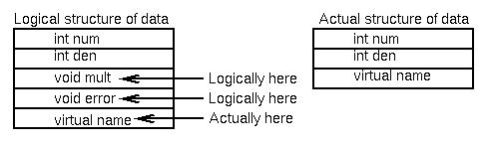
Implementing virtual functions
Virtual functions imply a runtime descriptor with a location of object
rational A;
complex B;
A.error() ⇐ error will call name() in rational
B.error() ⇐ error will call name() in complex

Slide 15
Example of Dynamic Binding
class shape {
public: virtual void area() = 0;
…}
class triangle: shape{area() {…}}
class square: shape{ area() {…}}
class circle: shape{ area() {…}}
void foo(shape polygon){
…
data = polygon.area;
…}
What implementation of area is actually called?

Slide 16
Additional C++ inheritance attributes
Problem: Want to access data from the class object.
That is, in rational::error, print values for num and den of each component of class object
Can use additional virtual functions
this pointers: *this.counter
Accesses counter object in actual object passed to error.
A.error(string X) compiled as: rational::error(&A, X)
That is, passes class object A as well as string X.

Slide 17
Friend classes
Friend classes: Strict inheritance sometimes difficult to do (i.e., Too hard to do it right so find a way around it!)
class thing { ...
MyFcn(complex A) { ... A.realpt }
But A.realpt is private data
Fudge solution by adding:
friend class thing
in complex class
Allows thing access to hidden components and avoid strict inheritance hierarchy of C++
Studies have shown this is most error prone feature of C++; redesign class hierarchy instead.

Slide 18
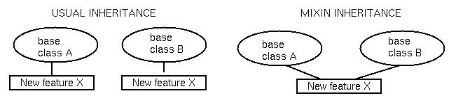
Mixin inheritance
Assume want to add feature X to both class A and B:
Usual way is to redefine both classes.
Mixin inheritance: Have definition which is addition to
base class (Not part of C++)
For example, the following is possible syntax:
featureX mixin {int valcounter} ⇐Add field to object
newclassA class A mod featureX;
newclassB class B mod featureX;
Can get similar effect with multiple inheritance:
class newclassA:A,featureX { ... }
class newclassB:B,featureX { ... }

Slide 19
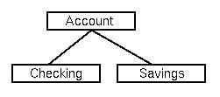
Inheritance principles
1. Specialization: Usual form of inheritance: Checking inherits properties of Account.
Opposite is generalization:
Account is more general
than Checking.
2. Decomposition: Breaking an encapsulated object into parts. A rational object is a num and a den.
Opposite concept is aggregation.
3. Instantiation: Creation of instances of an object:
rational A, B, C; ⇐ Represents 3 instantiations of object rational.
4. Individualization: Related to specialization.
Separate objects by function, not structure. A stack and a set can both be an array and and an index pointer, but functionality different.
Opposite is grouping.

Slide 20
Overloading
Two operators with the same name but different signatures are said to be overloaded.
Older languages allowed overloading on built-in functions, e.g., real+real is different from integer+integer is different from integer+real is different from real+integer
C++ overloading;
cout << 123 - the << operator is given arguments cout and 123.
cout << ``abc'' - the << operator is given arguments cout and ``abc''.

Slide 21
Overloading (continued)
Non-primitive overloading:
myfunction (int a, int b) { ... }
myfunction (int a) { ... }
Each signature differs, so a different function is called.
Note that this is a static property determined by the compiler.
What about the following:
myfunction (int a, int b=7) { ... }
myfunction (char a) { ... }
myfunction(3)?
myfunction('a')?

Slide 22
Overload resolution
In C++:
Given X(args) {...}
Given X(args) {...}
1. If signatures match exactly, second is a redeclaration of the first.
2. If the arguments match exactly, but the return types do not, the second is an error.
3. If the arguments do not match exactly, the second is an overloaded definition.
Related concepts:
Coercion: Often implemented as part of built-in overloaded operators (already discussed)
Polymorphism: Types are defined by a parameterized argument. (e.g., type mystring = string(N: integer);)
proc MyFunction(X: mystring(N)) {...}
call Myfunction(Mydata(17));
We will discuss polymorphism in more detail later.

